Slide 1


JAVA Programming Language
First presentation
FMSS Technology – Istanbul, Turkey

Slide 2



Content
JVM
Variables
Methods
Call by Value/Reference
Design Patterns

Slide 3

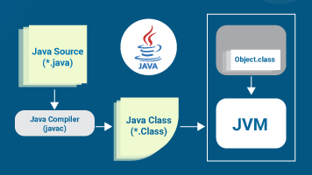
JVM – Java Virtual machine
What is JVM?
The JVM is the foundation of the Java platform. The JVM is an abstract computing machine. It has an instruction set and manipulates various memory areas at run time.
The JVM knows nothing of the Java programming language, only of a particular binary format, the class file format. A class file contains JVM instructions (or bytecodes) and a symbol table, as well as other supporting information.

Slide 4
JVM – Java Virtual machine
The JVM performs following operations:
Loads code
Verifies code
Executes code
Provides runtime environment

Slide 5
JVM – Java Virtual machine
The Run-Time Data Areas of the JVM:
The Java Virtual Machine defines various run-time data areas that are used during execution of a program. Some of these data areas are created on Java Virtual Machine start-up and are destroyed only when the Java Virtual Machine exits. Other data areas are per thread. Per-thread data areas are created when a thread is created and destroyed when the thread exits.
Let’s understand the internal architecture of JVM.

Slide 6
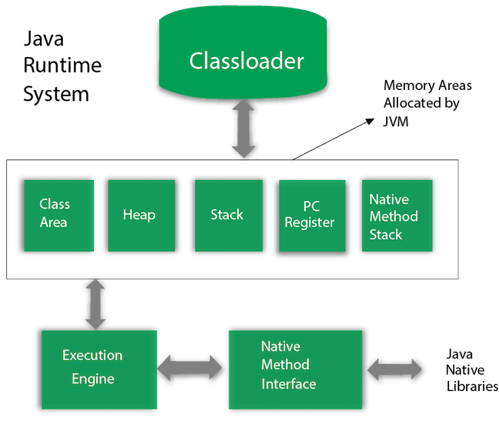
JVM – Java Virtual machine
JVM Architecture:
ClassLoader is a subsystem of JVM which is used to load class files. In the other words, a class loader is an object that is responsible for loading classes.

Slide 7

Java variables

Slide 8
Java variables (non-static)

Slide 9
Java variables (Static)
Real-Life Example:
Let’s start this slide with a real life example. Consider a machine that produces different varieties of pens like blue, black, green, etc. for two different companies.
All pens are different in their properties like some of them are blue having different body structure and some of them are black but one attribute is common among all the pens is its company name i.e. ‘X’. All pens that are manufactured for a particular having the same company name i.e. ‘X’.
After some time if we want to manufacture pens for a second company we simply update the company name variable to the name of the second company and after that, all pens that will be manufactured will be of the second company.

Slide 10
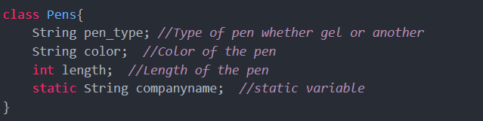
Java variables (Static)
Now consider if we want to implement the above example in a programming way. We can simply implement the above example in a simple form of class.
Now understand why the companyame variable is of static type because static variables are equally shared among all the objects of the class and also we are manufacturing pens symmetric procedure for first then second.
We can also initialize the companyname without static but this is not an efficient way the memory consumption is very much more in this case because for every object of this class a copy of companyname is initialized in the memory but if we initialized the companyname as static the memory allocation for this variable is different and also this variable is shared among all the instances of the class.

Slide 11
Java variables (Static)
Static Variable in Java
The static variables are those variables that are common to all the instances of the class; only a single copy of the static variable is created and shared among all the instances of the class. Because it is a class-level variable, memory allocation of such variables only happens once when the class is loaded in the memory.
What is the Use of Static Keyword in Java
The main use of the static keyword in java is used to manage the memory management in java. Whenever we place a static keyword before the initialization of a particular class’s methods or variables, these static methods and variables belong to the class instead of their instances (Objects).

Slide 12
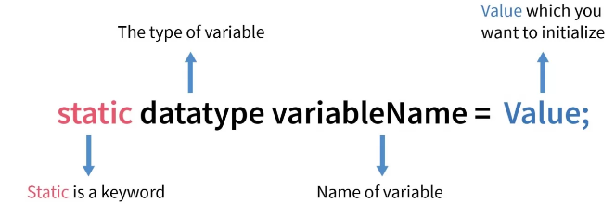
Java variables (Static)
Syntax of Static Variable in Java
The syntax of the static variable is similar to the syntax declaration of the static variable in java but the static keyword is used before the declaration of the variable.

Slide 13
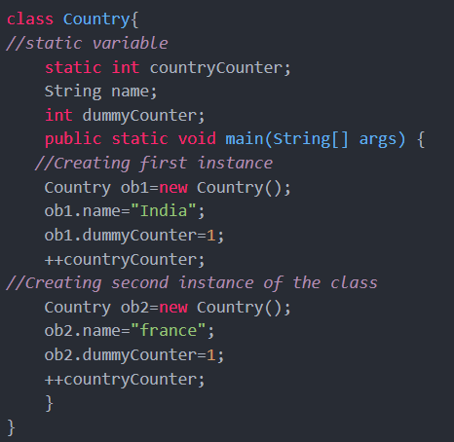
Java variables (Static)
Let’s look at an example:
In the example, we have a user-defined class country.java that has two class variables and one static variable.
First, we create the first instance of this class and increase the static variable named as countryCounter by one then we create a second instance of the class and increase the countryCounter by 1. The resultant value of the countryCounter is 2 because countryCounter is a static variable in java and due to the property of the static variable. It is shared among all the instances of the objects.

Slide 14
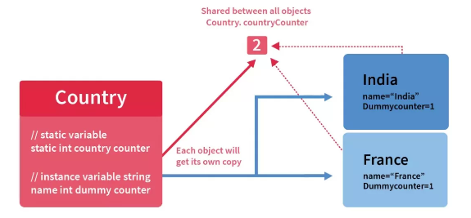
Java variables (Static)
Let’s working on the previous example diagrammatically
During compilation of the country.java file, the java compiler binds the static variables with the class as in this case countryCounter variable is bind to the compiled class.
We can see in the below diagram that the static variable countryCounter is linked to the class and this variable is shared among all the class instances.
In this case, two instances of the country class are accessing the same static variable shown below in the diagram. When we increment the countryCounter variable one because this variable is a static variable and static variable is a class variable so any changes in these variables are reflected among all the instances of the class so after the first increment the value of countryCounter is 1 and after another increment, the final value is 2.

Slide 15
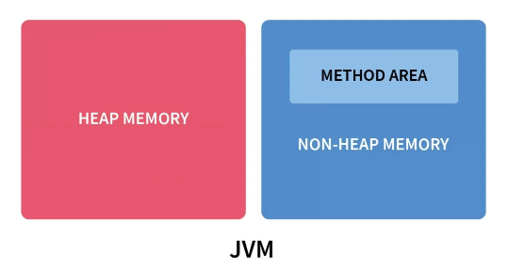

Java variables (Static)
Storage Area of Static Variable in Java
Before the Java 8 version, static variables of the class were stored in the separate section of the non-heap memory name as a memory area created by the Java virtual machine after compilation of the class. Method area section was used to store static variables of the class, metadata of the class, etc. Whereas, non-static methods and variables were stored in the heap memory.
After the java 8 version, static variables are stored in the heap memory.

Slide 16
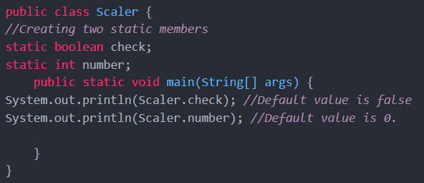

Java variables (Static)
How to Declare a Static Variable in Java?
Whenever we used static keywords before the initialization of the variable. The static keyword indicates to the JVM (java virtual Machine) that this variable should be loaded with the class whenever the class will be loaded during the compilation of the program.
If we don’t initialize the static variable the default value of the static variable data type will be automatically assigned to the static variable in java.
Output:

Slide 17
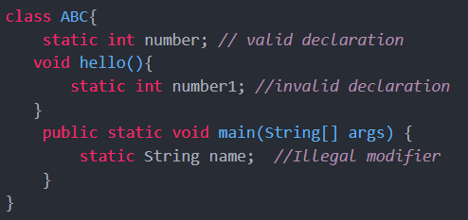
Java variables (Static)
Declaration Scope of the Static Variables in Java
We cannot declare static variables in the main method or any kind of method of the class. static variables must be declared like a class member in the class.
Because during compilation time JVM binds static variables to the class level that means they have to declare like we declare class members in the class. The static variables can be used only in the class scope where they are defined.

Slide 18
Java variables (Static)
Declaration Scope of the Static Variables in Java
The static variables in java can be declared like class members of the class like static int number, is the valid declaration of the static variable but static variables cannot be declared in any kind of method.
If we try to declare static variables inside static or non-static methods, the compiler will show a syntax error. In the example if we try to declare a static variable in the main method the compiler will show an illegal modifier syntax error. Because static variables are class variables rather than a particular method of the class, if we try to initialize the static variables inside the static methods, the compiler will show syntax error.
The static variables are also used as constants with the final keyword in java.

Slide 19
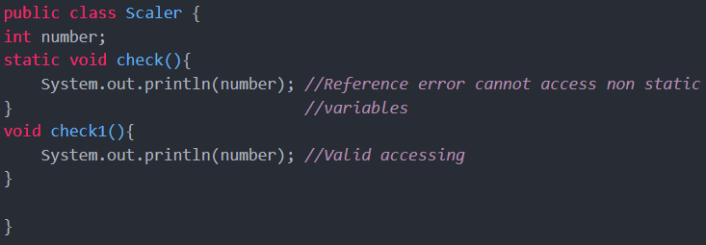
Java variables (Static)
Accessibility of the Static Variables in Java
Static variables can be accessed by calling the class name of the class. There is no need to create an instance of the class for accessing the static variables because static variables are the class variables and are shared among all the class instances.
The static variables can be accessed in the static methods only if we try to access the non-static variables in the static method compiler will show an error because non-static variables can only access by creating an instance of the class only but static methods can be called without creating an instance of the class and this leads to reference error for the non-static variable because non-static variables can be accessed only through the instance of the class that’s why static methods cannot access non-static variables.

Slide 20
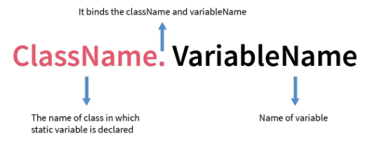
Java variables (Static)
Accessibility of the Static Variables in Java
In the example, a non-static variable named “number” is called in two methods: one is a static method and the other is a non-static method i.e. check1().
When the non-static variable is called inside the static methods, java compiler will show a reference error because we can only access the non-static variable only after creating an instance of the class but static methods can be called without creating an instance of the class that’s why during accessing the non-static variable in the static methods compiler will show reference error.
Syntax for Accessing:

Slide 21

Java Methods

Slide 22
Java Methods

Slide 23
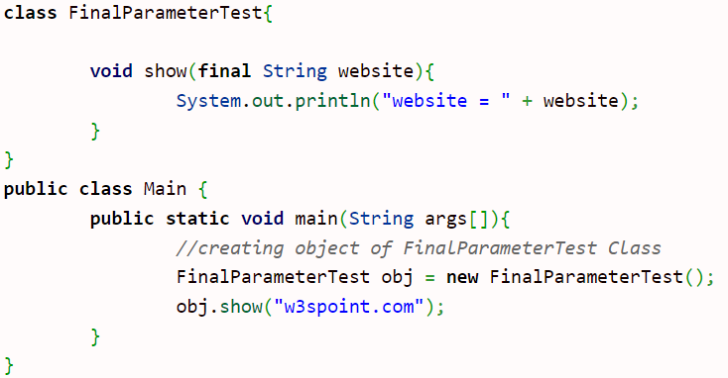
Java Methods (with final parameter)
In java, final parameter is a parameter which is declared with final keyword. Its value can not be changed.
Example:
Output:

Slide 24
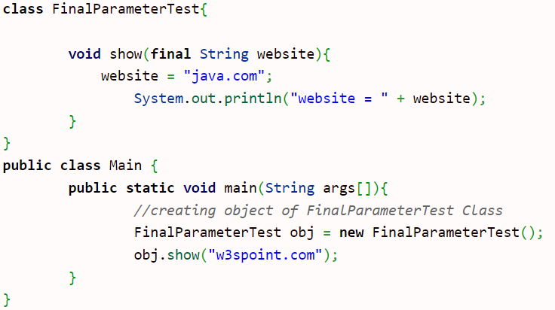
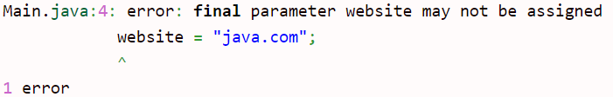
Java Methods (with final parameter)
we will get compile time error, if we try to change the final parameter.
Example:
Output:

Slide 25
Java Methods (with final parameter)
we will get compile time error, if we try to change the final parameter.
Example:
Output:

Slide 26


Call BY VALUE/REFERENCE
What is Call by Value and Call By Reference?
A method or a function can be called in two ways. One is Call by Value and the other is Call by Reference, both ways are generally differentiated by the type of the value passed to them as an input or as a parameter.
Call by Value is an approach where the passing of a parameter to a function is carried out by copying the actual value of a given variable ( or constant or anything that holds data)
This means when we call a method with passing argument value of the parameter, then this argument value is copied into a portion of memory (depending on the type), and a copy of the value is passed to the parameter of the calling method.
In Java there is only call by value, not call by reference.

Slide 27
Call BY VALUE/REFERENCE
Call by Reference is an approach that passes a reference (i.e. address) of the value to a method.
This means when we call the method by passing the copy of a reference (i.e. address) to the value of that method and not a copy of value itself, then the calling method has a reference (i.e. address) of that value.
When the calling method changes the reference of the value the original reference also changes.
In Java there is only call by value, not call by reference.

Slide 28
Call BY VALUE/REFERENCE
Difference Between Call by Value and Call by Reference
Call by Value | Call by Reference
The original value is NOT modified. | The original value is modified.
A copy of the variable is passed. | Variable itself is passed or Reference of that Variable is passed.
The actual and formal arguments will be created on the different memory locations. | The actual and formal arguments will be created in the same memory location.
Copy of the Variables are directly passed to the method. | The pointer of that variables is required to store the address of that variables.
In Java there is only call by value, not call by reference.

Slide 29
Call BY VALUE/REFERENCE
Why In Java there is only Call by Value, NOT Call by Reference?!
By definition, the call by reference is where we are passing the reference (i.e. address) of that variable. To do that, we need to store the address first which will require a pointer (in C, its passed as *variableName). And as we know in java we do not have a pointer so it is not possible to pass a reference (i.e address) and perform call-by-reference.
Java does not support Pointers that’s why Java does not support Call by Reference. But C/C++ supports pointers, hence these languages support Call by Reference.
But still, we can achieve Call By Reference in Java with the help of Object Dramatic Behavior.
In Java there is only call by value, not call by reference.

Slide 30
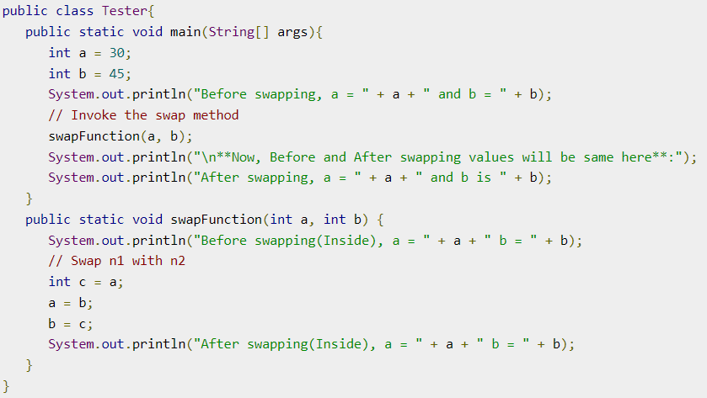
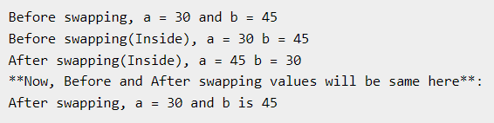
Call BY VALUE/REFERENCE
Example: Call by Value
The following program shows an example of passing a parameter by value. The values of the arguments remain the same even after the method invocation.
Output:

Slide 31
Call BY VALUE/REFERENCE
Call By Reference in Java, But How?
Java always uses call by value. which means the method gets a copy of all parameter values, and the method can’t modify the content of that variable passed. Java uses two kinds of method parameters:
Java Primitive Types
Java Object References
It seems very straightforward and simple, as when you pass primitive types to a method. But it is dramatic when it comes to passing the objects to the method. when an object is passed to a method, the method gets a copy of the object reference, and both the original and the formal copy refer to the same object, therefore within the calling method, the state of an object parameter can be changed.
In Java there is only call by value, not call by reference.

Slide 32
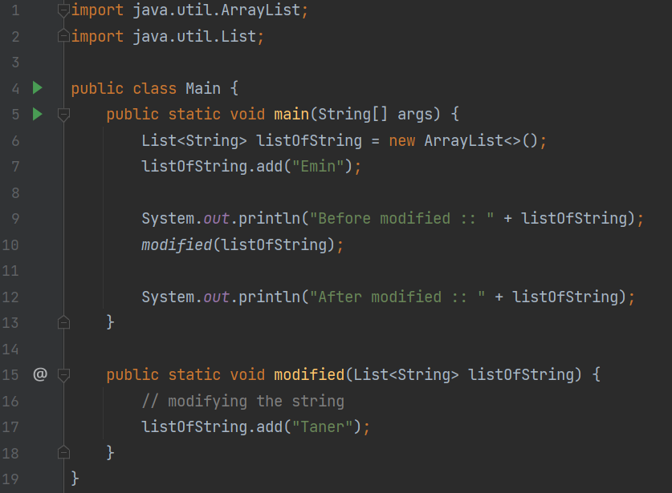

Call BY VALUE/REFERENCE
Example: Call by Reference – Object References
Let’s see how it works:
In example we have created an object of ArrayList and added one string value Emin in it. Now the List have a data as one String with value Emin.
In Next Line we called the method modified which takes a List and adds one more String Taner to the same given List
But when we call that modified method the Java Object Reference takes place instead of value. It passes the reference of list which is nothing but the actual object of list
This results into modifying the original list also.
Output:

Slide 33
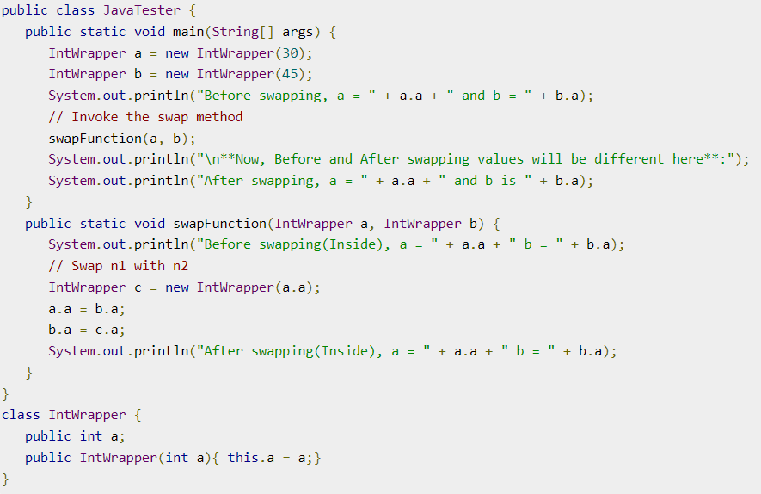
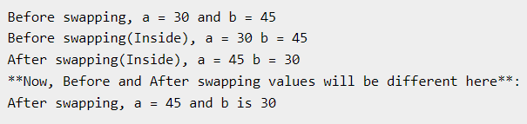
Call BY VALUE/REFERENCE
Example: Call by Reference
Java uses only call by value while passing reference variables as well. It creates a copy of references and passes them as valuable to the methods. As reference points to same address of object, creating a copy of reference is of no harm. But if new object is assigned to reference it will not be reflected.
Output:

Slide 34

Design patterns(Introduction)
Design Patterns are sets of solutions to common design problems that occur over and over in development.
They work as a solution template in which an abstract solution for a common problem is described and the user then applies it, adapting it to their problem.
In object-oriented programming, the design pattern provides a way to design reusable classes and objects for a specific problem as well as defining the relationship between objects and classes.
In addition, design patterns provide a common idiom among programming languages that allows architects and software developers to communicate about a common and recurring problem regardless of the programming language they are using.

Slide 35
Design patterns(Introduction)
The design patterns theme gained strength in 1994 after the Gang of Four wrote Design Patterns: Elements of Reusable Object-Oriented Software.
The Gang of Four (GoF) design patterns that are classified as creational, structural, and the behavioral patterns.
The creational patterns control the creation and initialization of the object and class selection; the structural patterns define the relationship between classes and objects, and the behavioral patterns control the communication and interaction between objects.
As well as this, the GoF design patterns have two types pf scope which define the focus of the solutions. These scopes are object scope, which resolves problems about object relations, and class scope, which resolves problems about class relations.
Patterns classified as class scope solve problems about the relationship between classes and are static (fixed at compile time and cannot be changed once compiled). However, patterns classified under the object scope solve problems about the relationship between objects and can be changed at runtime.

Slide 36
Design patterns(Introduction)
The following table shows us the three classifications, as well as their patterns and scope:
 | Creational | Structural | Behavioral
Class | Factory Method | Adapter | Interpreter Template Method
Object | Abstract Factory Builder Prototype Singleton | Adapter Bridge Composite Decorator Facade Flyweight Proxy | Chain of Responsibility Command Iterator Mediator Memento Observer State Strategy Visitor
A design pattern is a great tool for designing software development, but its use needs to be analyzed to determine if the design pattern is really required in order to solve the problem.

Slide 37
Design patterns(Introduction)
Advantages of Design Patterns:
Creating an object-oriented design is a tough task. This is because we have several important elements to think about with regard to the scenario that we'll work in and the problem we'll solve. This includes defining the appropriate objects that we need to create in order to reach the solution; defining the granularity of objects and looking at what interfaces we need to create. These tasks need to be addressed during the creation process in design. Objects can be created to represent a real-world object or to represent a process with its algorithms and responsibilities. Furthermore, we even need to consider the number of objects, their size, and the interface we need to access.
Design patterns are great tools for helping us to identify classes and objects that don't represent real-world objects and objects that are less-obvious abstractions. Moreover, design patterns help us to apply the finest granularity to objects and they also allow us to analyze a problem and solution as a model. Design patterns make the design flexible, providing a decoupling between classes and objects. They also provide the ability to organize solutions, allowing delegate responsibilities to classes with the best way.

Slide 38

Design patterns(Introduction)
Advantages of Design Patterns:
They are reusable in multiple projects.
They provide the solutions that help to define the system architecture.
They capture the software engineering experiences.
They provide transparency to the design of an application.
They are well-proved and testified solutions since they have been built upon the knowledge and experience of expert software developers.
Design patterns don’t guarantee an absolute solution to a problem. They provide clarity to the system architecture and the possibility of building a better system.

Slide 39


Design patterns(Creational)
Creational Design Patterns:
Creational design patterns are concerned with the way of creating objects. These design patterns are used when a decision must be made at the time of instantiation of a class (i.e. creating an object of a class).
But everyone knows an object is created by using new keyword in java. For example:
Hard-Coded code is not the good programming approach. Here, we are creating the instance by using the new keyword. Sometimes, the nature of the object must be changed according to the nature of the program. In such cases, we must get the help of creational design patterns to provide more general and flexible approach.

Slide 40
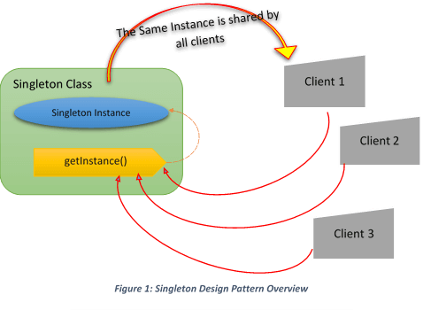
Design patterns(Singleton)
In this presentation we will discuss Singleton Design Pattern.
This design pattern ensures that a class has only one instance in the entire project, and the same instance of the object is returned every time the creation process is performed/run.
Singleton Design Pattern Overview

Slide 41
Design patterns(Singleton)
Concept:
Let’s assume you have a class called A and you need to create an object from it. Normally what do you do? You guess it right; you simply use the following line of code: A obA =new A(); But let’s look at it closely. If you keep using the new keyword ten more times, you’ll have ten more objects. Right? But in a real-world scenario, unnecessary object creation is a big concern (particularly when constructor calls are truly expensive), so you need to restrict this. In a situation like this, the Singleton pattern comes into the picture. It restricts the use of new like this and ensures that you do not have more than one instance of the class.
In short, this pattern says that a particular class should have only one instance. You can create an instance if it is not available; otherwise, you should use an existing instance to serve your need. Following this approach, you can avoid creating multiple objects.

Slide 42
Design patterns(Singleton)
Real-Life Example:
Let’s assume that you have a sports team, and your team is participating in a tournament. Your team needs to play against multiple opponents throughout the tournament. At the beginning of each match, as per the rules of the game, the captains of the two sides must go for a coin toss. So, if your team does not have a captain, you need to elect someone as a captain first. Prior to each game and each coin toss, you may not repeat the process of electing a captain if you have already nominated a person as a captain of your team for this tournament. Notice that in this example, selecting a captain is like creating a new object. Having that captain for the rest of the season is like reusing the same object that was created at the beginning.

Slide 43
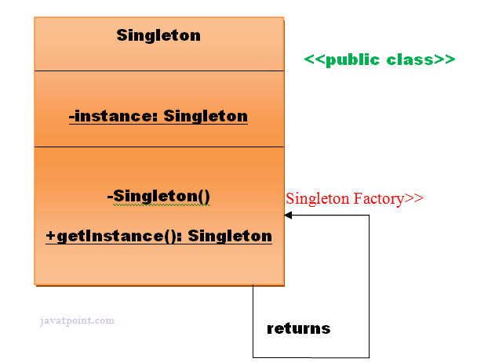
Design patterns(Singleton)
In a software project, in some solutions, we may want to ensure that a class has only one instance of an object throughout the project and that this object is accessible at any point in the project. Creating a global instance or static instance will not ensure that this class will not be used at another point in another instance. The best way to solve this is by using the Singleton pattern, which ensures that there is only one instance of a class in the entire project. In the following diagram, we are showing the structure of Singleton and how it is designed:
Here, we have one class called Singleton which has a private constructor, as well as a reference variable of Singleton and a method for returning its unique instance.

Slide 44
Design patterns(Singleton)
There are two forms of singleton design pattern:
Early Instantiation: creation of instance at load time.
Lazy Instantiation: creation of instance when required.
Advantage of Singleton design pattern:
Saves memory because object is not created at each request. Only single instance is reused again and again.
Usage of Singleton design pattern:
Singleton pattern is mostly used in multi-threaded and database applications. It is used in logging, caching, thread pools, configuration settings etc.
This pattern is often used in frameworks and APIs, but it is common for this pattern to be found in the code of projects, mainly on Java EE.

Slide 45
Design patterns(Singleton)
How to create Singleton design pattern?
To create the singleton class, we need to have static member of class, private constructor and static factory method.
Static member: It gets memory only once because of static, itcontains the instance of the Singleton class.
Private constructor: It will prevent to instantiate the Singleton class from outside the class.
Static factory method: This provides the global point of access to the Singleton object and returns the instance to the caller.
Let’s briefly talk about Lazy initialization and Eager/Early initialization in the upcoming slides.

Slide 46
Lazy initialization

Slide 47

Thank You!
Amin D. Alamdari
Email: amin.alamdari@ozu.edu.tr

